Slide 1


CAPSTONE PROJECT
PROJECT TITLE: HR ANALYsis – HIRING, ATTRITION
Presented By
Student Name: GUMMADI PRADEEP KUMAR SHISHIRA
College Name: MALLA REDDY engineering college FOR WOMEN
Department: computer SCIENCE engineering(Data science)
Email ID: gpshishirasagar@gmail.com

Slide 2
OUTLINE:
Problem Statement
Proposed System/Solution
System Development Approach
Algorithm & Deployment
Result (Output Image)
Conclusion
Future Scope
References

Slide 3
Problem Statement:
Recruitment processes generate large volumes of HR data, but manual analysis and fragmented systems make it difficult to gain meaningful insights. This leads to inefficiencies in hiring, poor tracking of recruitment performance, and delayed decision-making. An HR Analysis Dashboard is needed to visualize recruitment data, identify trends and bottlenecks, and support effective, data-driven hiring decisions.

Slide 4
Proposed Solution:
The proposed system aims to improve recruitment decision-making by providing a centralized HR Recruitment Analysis Dashboard that transforms raw HR data into meaningful insights.
Data Collection: Recruitment-related data such as candidate details, hiring stages, departments, and attrition records are collected from historical HR datasets.
Data Preprocessing: The collected data is cleaned and preprocessed to handle missing values, inconsistencies, and duplicates. Relevant features are extracted to support effective analysis.
Data Analysis & Visualization: Analytical techniques are applied to identify hiring trends, recruitment performance, and bottlenecks. Interactive visualizations are used to present insights in an intuitive manner.
Dashboard Development: A user-friendly dashboard is developed to allow HR professionals to monitor key recruitment metrics, filter data, and generate insights in real time.
Evaluation: The system is evaluated based on accuracy, usability, and effectiveness in supporting data-driven recruitment decisions.
Result: The proposed solution enables efficient recruitment analysis, improved hiring strategies, and informed workforce planning.

Slide 5
System Approach:
The system approach outlines the methodology used to develop the HR Recruitment Analysis Dashboard using Power BI for effective visualization and decision-making.
System Requirements:
Historical HR recruitment dataset (CSV / Excel)
Computer system with minimum 8 GB RAM
Microsoft Power BI Desktop
Windows operating system
Stable internet connection for data refresh and sharing
Tools / Components Used:
Power BI Desktop – Dashboard development and visualization
Power Query – Data cleaning and transformation
DAX (Data Analysis Expressions) – Calculated measures and KPIs
Excel / CSV – Data source integration

Slide 6
Algorithm & Deployment:
This section describes the analytical approach used to process and analyze recruitment data for the HR Recruitment Analysis Dashboard.
Algorithm Selection
The system uses descriptive and diagnostic analytics rather than predictive machine learning algorithms, as the objective is to analyze historical recruitment data and evaluate hiring performance. Power BI’s analytical engine and DAX (Data Analysis Expressions) are employed to compute recruitment metrics and generate insights.
Data Input
The algorithm takes HR recruitment data as input, including candidate details, job roles, departments, hiring status, recruitment stages, and attrition information. The data is imported from structured sources such as CSV or Excel files.
Processing Logic
Data preprocessing and transformation are performed using Power Query to handle missing values, remove inconsistencies, and standardize the data. Key performance indicators such as total hires, attrition rate, department-wise recruitment, and hiring trends are calculated using DAX formulas.
Analysis & Output Generation
The processed data is visualized using interactive dashboards, charts, and slicers in Power BI. These visual outputs enable HR professionals to analyze recruitment trends, identify bottlenecks, and make informed, data-driven recruitment decisions.

Slide 7
Result:
The HR Recruitment Analysis Dashboard successfully provides meaningful insights into the recruitment process through interactive and visual analytics.
The dashboard presents key recruitment metrics such as total hires, department-wise recruitment, hiring trends, and attrition rates in a clear and intuitive manner. Visualizations including bar charts, line graphs, KPI cards, and filters enable users to compare recruitment performance across departments and time periods.
The results demonstrate improved visibility into recruitment patterns, helping HR teams identify bottlenecks, monitor hiring efficiency, and make informed, data-driven decisions. The use of Power BI ensures accurate, real-time analysis and enhances the overall effectiveness of recruitment planning and workforce management.
.

Slide 8
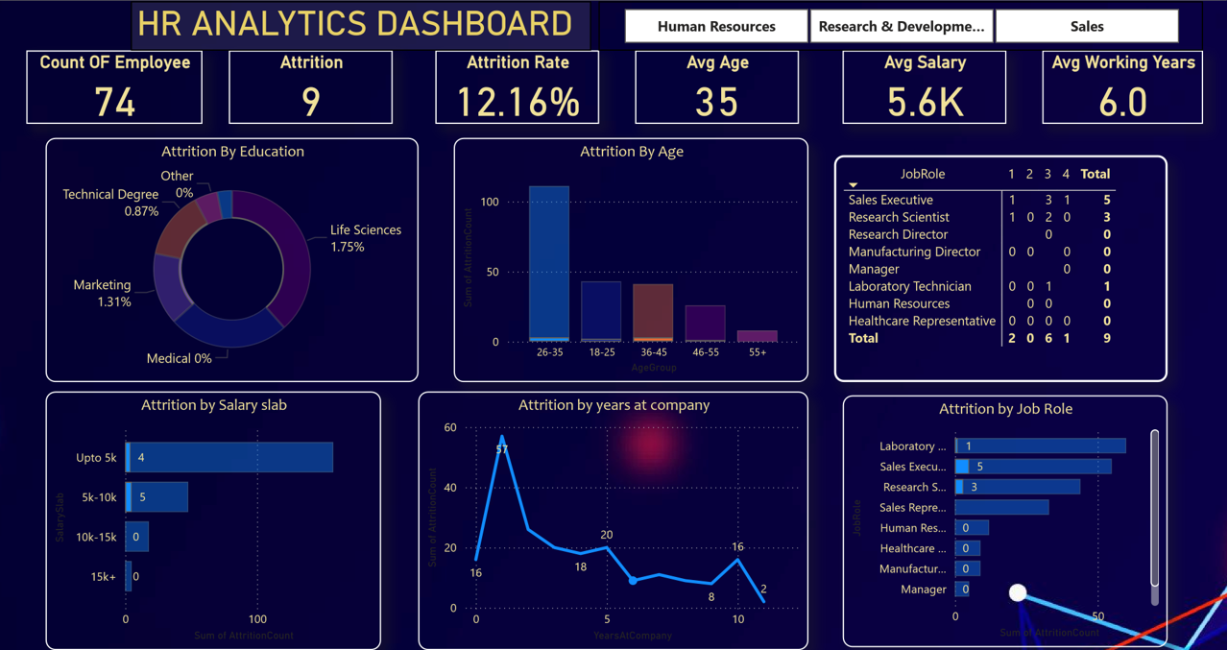

Slide 9
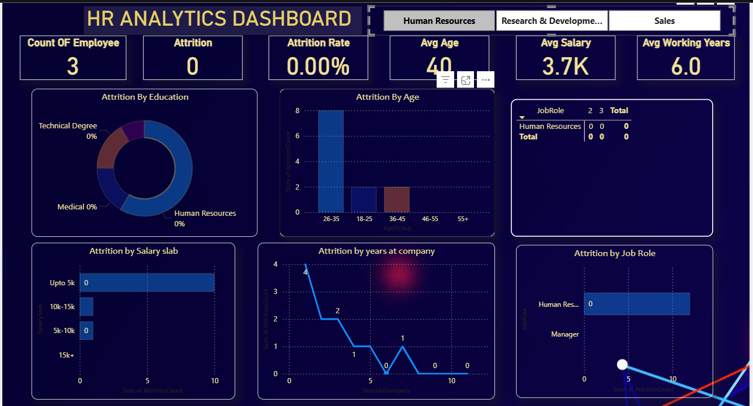

Slide 10
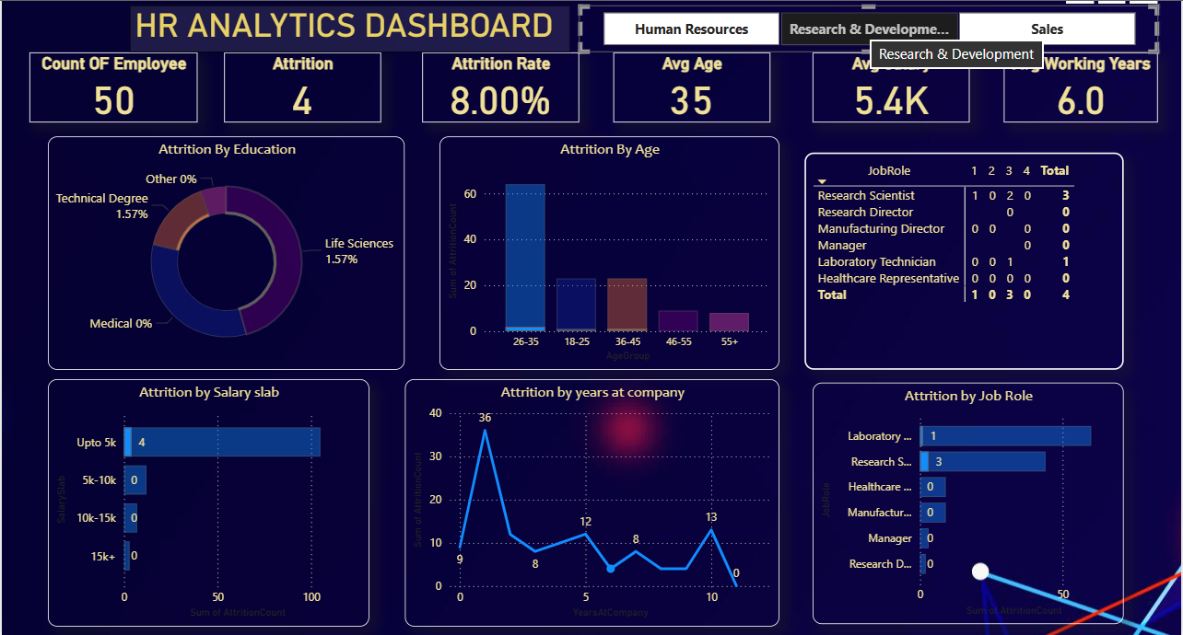

Slide 11
Conclusion:
The HR Recruitment Analysis Dashboard provides an effective solution for analyzing and visualizing recruitment data using Power BI. By transforming raw HR data into interactive dashboards, the system enables HR professionals to monitor hiring trends, evaluate recruitment performance, and identify areas for improvement. The project enhances transparency, supports data-driven decision-making, and helps organizations improve recruitment efficiency and workforce planning.

Slide 12
Future scope:
The HR Recruitment Analysis Dashboard can be further enhanced by integrating additional HR data sources such as employee performance records, payroll data, and training information to provide deeper workforce insights. Real-time data integration from HR management systems can improve data accuracy and dashboard responsiveness.
Advanced analytics and machine learning techniques can be incorporated to predict hiring needs, employee attrition, and recruitment timelines. The system can also be expanded to support multi-location or region-wise recruitment analysis for large organizations.
Future enhancements may include automation of data refresh, role-based access control, cloud deployment using Power BI Service, and integration with AI-driven HR tools to support strategic workforce planning and decision-making.

Slide 13
References:
List and cite relevant sources, research papers, and articles that were instrumental in developing the proposed solution. This could include academic papers on bike demand prediction, machine learning algorithms, and best practices in data preprocessing and model evaluation.
GitHub Link: https://github.com/shishira-sagar/Microsoft-Elevate-AICTE-Power-BI-Internship-Feb-2026.git

Slide 14
Thank You

